Slide 1
Enabling Excellence in Education
Monolithic – Modular N Tier – Micro Services Architecture
July, 2018

Slide 2
Agenda
Monolithic to Modular N Tier Architectural Style
Where are we with Special Ed and MiSiS application in LAUSD?
Driving factors to Step in from Modular Design to MSA (Micro Services Architecture)
SPED, Attendance, Enrollment, Scheduling etc. require MSA? Is it right ROI?
Containers with Modularization using Azure Service Fabric
Containers with Modularization + DevOps Micro Services Architecture
Current Build\Release Cycle, Deployment Topology with Modularization and Challenges

Slide 3
Monolithic to Modular N Tier Architectural Style
Monolithic Style Challenge's
Complete deployment for small change.
Modular N Tier
Agility
Scaling, Availability and maintenance Challenge.
Development challenge, in terms of huge code base.
Difficult to migrate to new technology.
Tightly Coupled design.
Autonomous
Single Responsibility and fine grained services.
Technology agnostic
Developed, Deployed and Updated Independently.
Scaled Independently and granular scaling in terms of functional modules.
loosely coupled.
Supports multiple variants of clients such as Fat, thin and Hybrid clients.

Slide 4
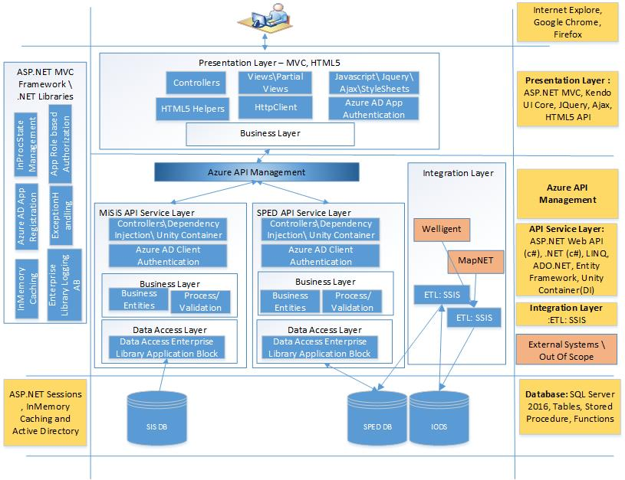
Where are we with Special Ed application in LAUSD?
Special Ed application supports layered and Modular Architecture with fine grained services.
Developed with single technology stack.
Supports loosely coupled design.
Supports CICD which uses TFS for build and release definitions.
Seamless deployment of Modules, supports deployment on On Premise, IaaS and Pass Model of Azure.

Slide 5
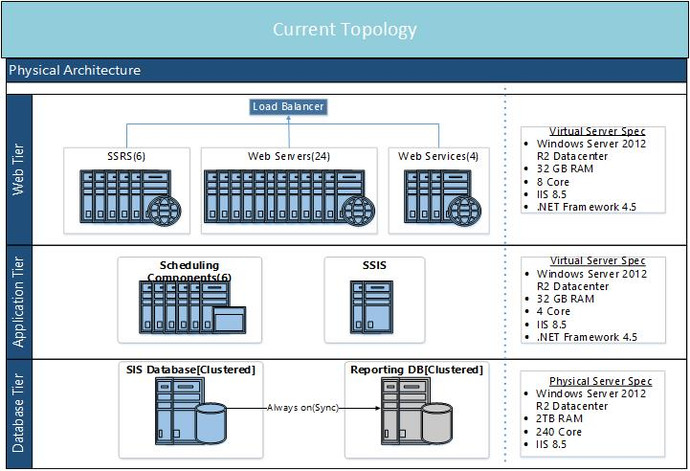
Where are we with MiSiS application in LAUSD?
Current State
Currently MiSiS application is Monolithic, with all modules running under single website hosted under 24 Web servers.
Difficult to manage code as all of the modules functionality implemented in single solution.
Application is not scalable in terms of functionality.
Road Map
Build layered and modular design for each of modules in MiSiS, which supports loosely coupled design.
Web apps and API apps are recommended to be hosted as PAAS, in order to get full benefit of cloud including auto scale option.

Slide 6
Driving factors to Step in from Modular Design to MSA
1
DDD
Design domain driven and cohesive API’s: Keeping business domain in mind API’s should be designed. Group functionalities which needed to be changed together.
2
Each of the Modular applications chosen to be developed in different technology stack and deployed in various operating systems. Maintenance of environments would be a challenge.
Platform and Technology agonistic
Key Market Drivers
3
Containerization
When modular applications are being deployed under IaaS model, which would occupy separate large VM for each small application is not efficient. Containerization would embrace MSA, in place of Virtualization.
4
DevOps
Motivation behind Micro services architecture is to embrace DevOps to gain value

Slide 7
SPED, Attendance, Enrollment, Scheduling etc. require MSA? Is it right ROI?
Factors which would lead for MSA :
Each of the modular application would be having Development, Testing and Production environment deployments for
Application and service layer – Maintaining and deploying each of the environment would be overhead and challenging.
Cloud Adoption: When each of the modules deployed in IaaS and Pass model, would occupy large VM which is not efficient.
Release cycles are lengthy which on average is taking 45 mins across all of the environments for MiSiS project.
Release pipeline to be supported for on premise, PaaS and IaaS model.
Factors which would not influence MSA:
Modules don’t require to be platform agnostic.
On Premise: Containerization of modules not required in terms different OS. Each of the module would need to be supported for development, testing and production.
 |  | Enrollment | Scheduling | Attendance | Grades | Student support | Student service | Student Testing | Groups | Census | Misc && Admin
Application | Dev | Yes | Yes | Yes | Yes | Yes | Yes | Yes | Yes | Yes | Yes
 | QA | Yes | Yes | Yes | Yes | Yes | Yes | Yes | Yes | Yes | Yes
 | Prod | Yes | Yes | Yes | Yes | Yes | Yes | Yes | Yes | Yes | Yes
Service | Dev | Yes | Yes | Yes | Yes | Yes | Yes | Yes | Yes | Yes | Yes
 | QA | Yes | Yes | Yes | Yes | Yes | Yes | Yes | Yes | Yes | Yes
 | Prod | Yes | Yes | Yes | Yes | Yes | Yes | Yes | Yes | Yes | Yes

Slide 8
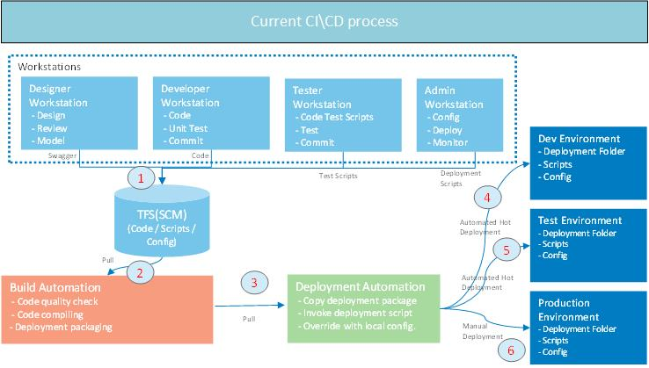
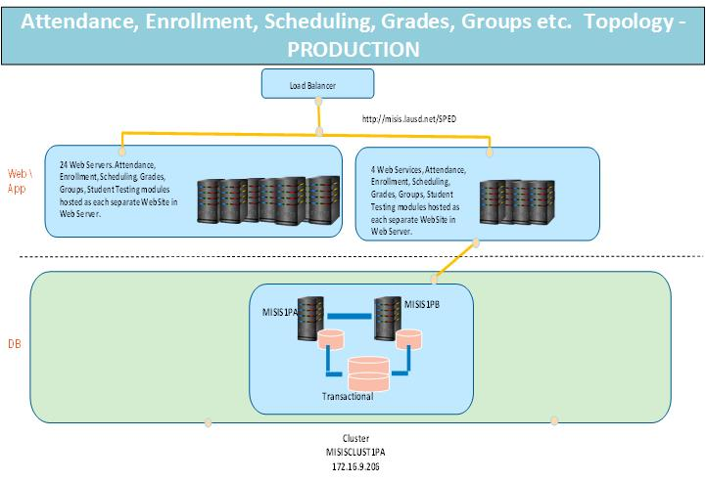
Current Build\Release Cycle, Deployment Topology with Modularization and Challenges
Build and Release pipe line not integrated with defects management and Test automation.
For each of 9 modules (Application and Service), need to build and deploy in Dev, QA and Prod .
On Average, takes more than 1 hour for Build and deployment for 9 modules across environments, currently takes 30 to 45 mins.
Difficult to keep track of multiple servers having total of 18 websites hosted in Web Server.
Challenge and overhead to maintain 24 Web servers, each Web Server having 10 sites approximately. Total of 240 Sites in Web Server.
Challenge and overhead to maintain 4 Web Servers, each having 10 Web Apps running approximately. Total of 40 Sites to be maintained.
Complex deployment architecture with 9 different modules each having two different sites.
Challenge for IT operations for managing and monitoring 18 sites in single webserver.

Slide 9
DevOps
Profiling current CICD process with DevOps :
DevOps Attribute | How its practiced in Misis CI\CD
Speedy, reliable releases and handling and responding to production defects | Partially supported
Data driven decision feedback on software running in production to development teams and decision makers. | Not Supported
Tool and process mismatches such as development teams deploy with one tool and operations team deploy with another | No Such issues
Fully automated release pipeline with no manual steps | Partially supported
Re-building just to deploy to the next environment | No Such issues
lack traceability and have issues understanding which versions have been released. | Yes
Release cycles are lengthy, even for hotfixes. | Yes
Is Continues integration testing enabled in Release pipe line. | No
Code Provisioning : Making Release pipeline to be supported for on premise, PaaS and IaaS model. | Partially supported
Build and Release management integrated with Test and QA automation | No

Slide 10
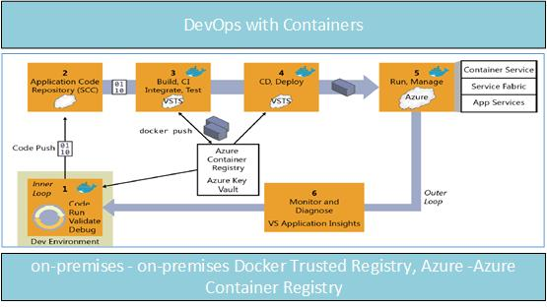
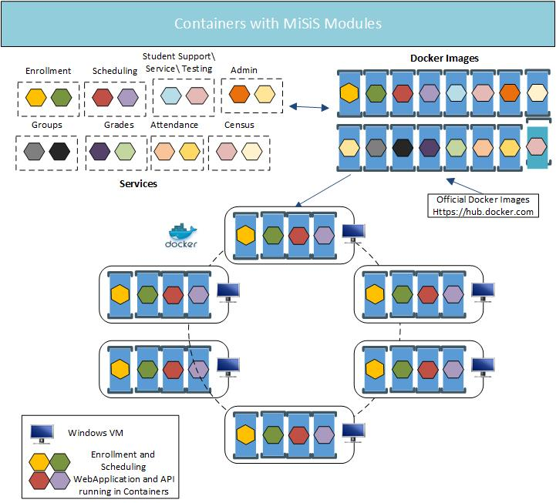
Containers with Modularization + DevOps = MSA
Benefits of Containerization with Modularization (Container based Microservices) :
As part of Containerization with Modularization, adopting with DevOps would strengthen the automation:
Containers simplify the build/test/deploy pipelines in DevOps.
Down time of daily Build and Release cycle can be reduced.
Code quality – Build and Release pipeline Integrating with Unit testing, Automation testing, Load testing and integration testing.
Can develop and deploy applications and services which are more infrastructure agonistics. They could run under – On-Premise, Microsoft Azure, Customer Datacenter, other cloud service providers.
Development and deployment issues related to infrastructure could be addressed, and would be easy for IT Operations team.
Containers are easily scalable, which would occupy less footprint compared with VM’s.
Applications would be more resilient, as containerization platform supports detecting and restarting failed services.

Slide 11
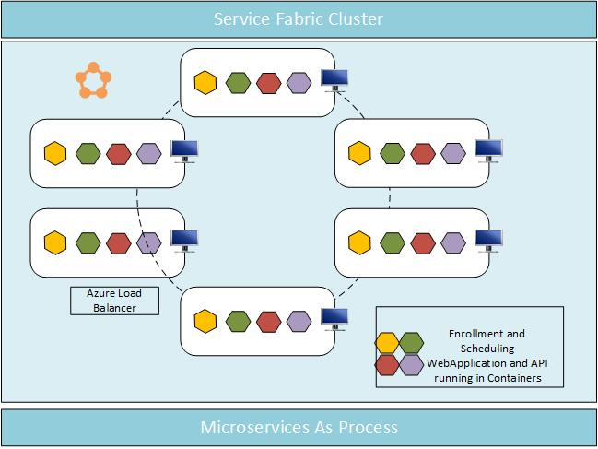
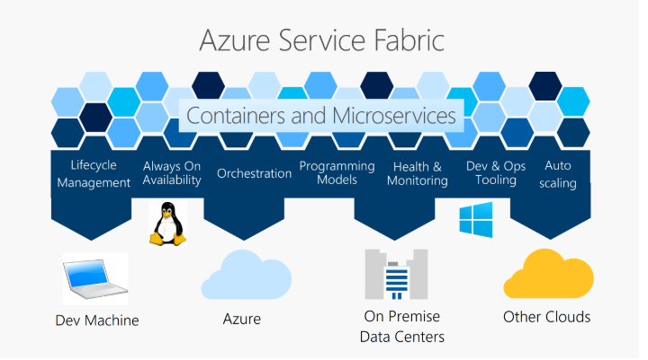
Containers with Modularization using Azure Service Fabric
Challenges in hosting modules in PaaS and On premise
All 9 Modularized modules needed to be hosted either with Dedicated Compute, Isolated and ASE app service plan. Will take VM Image for each of the website.
Again maintaining or health monitoring of Websites would be the challenge either hosted in PaaS model or in On Premise.
Benefits of Implementing Modularization with Azure Service Fabric:
Provides Azure Service Fabric Container portal which provide details of Applications health status deployed in Nodes\VM.
Azure Service Fabric container can as well be used with On Premise, with simple lift and shift supports deployment to Azure(PaaS model).
Supports multiple application models.
Applications can be developed platform agonistic.
Applications with Azure Service Fabric can also developed with other could environments such AWS, google cloud etc.

Slide 12
Enabling Excellence in Education
Thank You

